Slide 1
BB2950 Day 15: Friday 11-17-17
Learning objectives:
Describe how reverse transcriptase is used as a tool in multiple methods for measuring gene expression.
Explain how quantitative PCR is used to measure gene expression.
Explain how microarrays are used to measure gene expression.
Explain how RNAseq is used to measure gene expression.

Slide 2
Project: using the knowledge and tools of molecular biology to tackle human disease
Three categories of disease:
Antibiotic-resistant bacterial pathogens
Cancer
Allergy and autoimmunity
Three levels of study:
Knowledge
Treatment
Gene identification
Gene function
Gene targeting

Slide 3
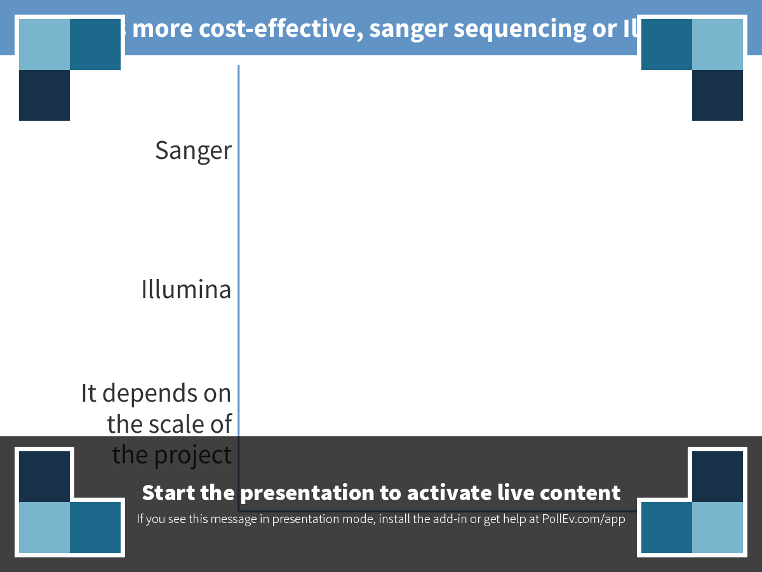
Notes:
Which is more cost-effective, sanger sequencing or Illumina?
https://www.polleverywhere.com/multiple_choice_polls/uz6YAEvVcAHWqy6

Slide 4
Notes:
Which is more cost-effective, sanger sequencing or Illumina?

Slide 5
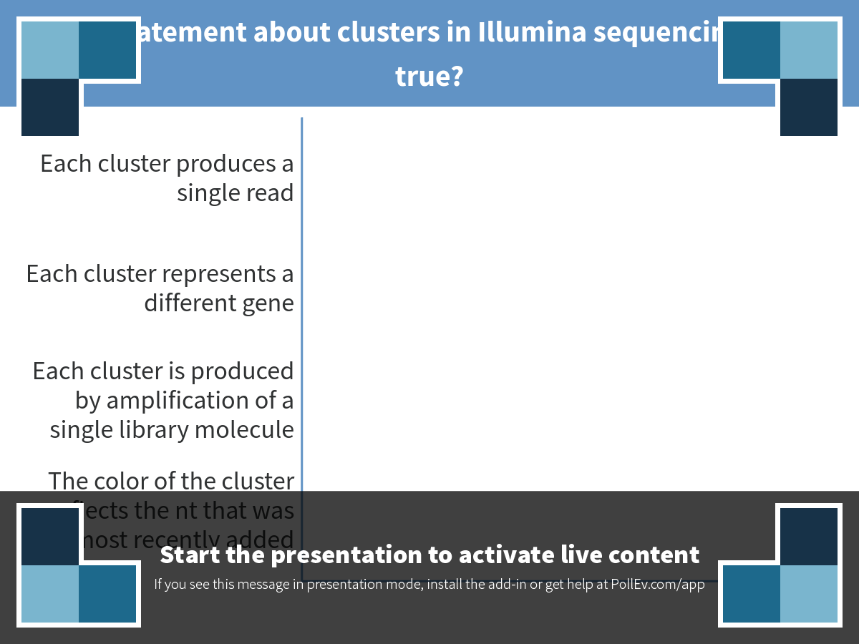
Notes:
Which statement about clusters in Illumina sequencing is NOT true?
https://www.polleverywhere.com/multiple_choice_polls/rgZOaCObEeqPBYg

Slide 6
Notes:
Which statement about clusters in Illumina sequencing is NOT true?

Slide 7
Why might you want to measure gene expression?
Determine the effect of a perturbation on phenotype (eg, drug, stress condition, etc)

Slide 8
Some techniques for measuring gene expression
Quantitative PCR
Microarrays
RNAseq

Slide 9
Quantitative PCR (aka qPCR, RT-PCR, qRT-PCR)

Slide 10
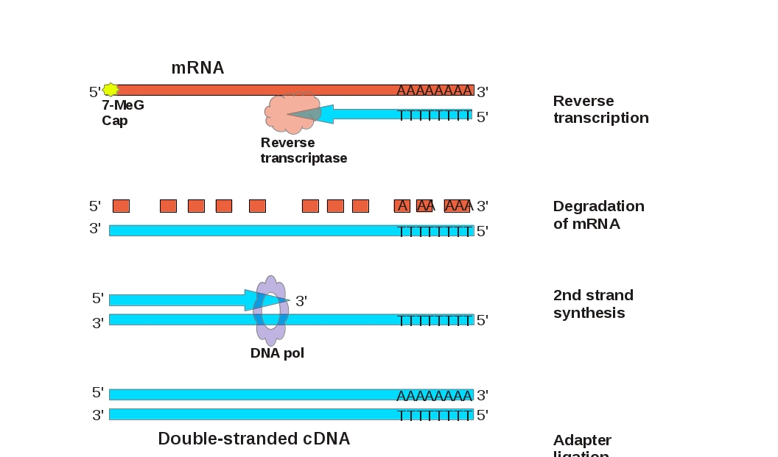
Using reverse transcription to make cDNA from RNA
http://bio1511.biology.gatech.edu/module-5-integrative-health/01-recombinant-dna/

Slide 11
Why not just do a regular PCR and compare the intensity of the bands on a gel?

Slide 12
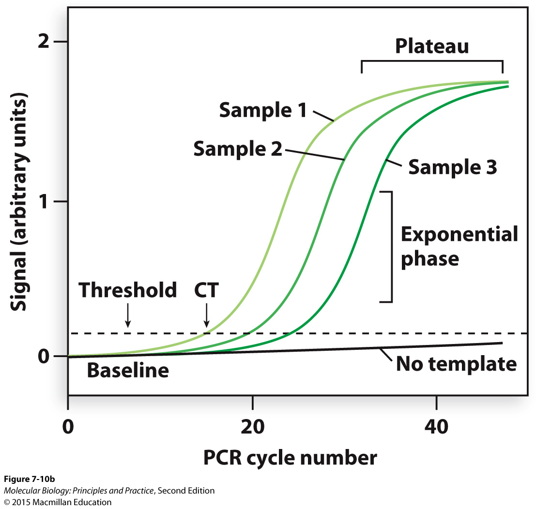
Amplification is exponential only in the early cycles of PCR

Slide 13
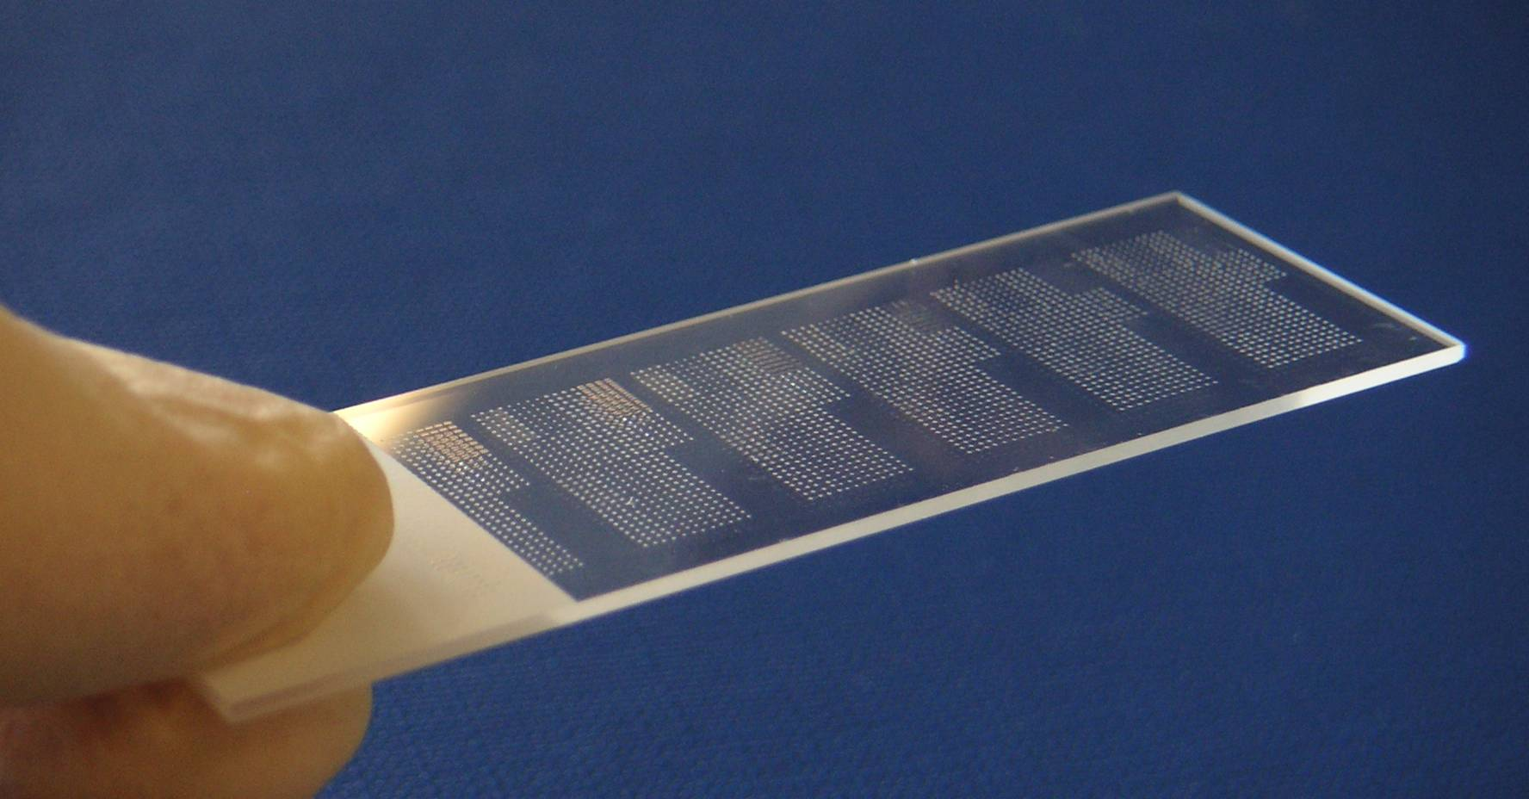
Microarrays
Thousands of oligonucleotides (ssDNA) arrayed on a glass slide
oasys2.confex.com

Slide 14
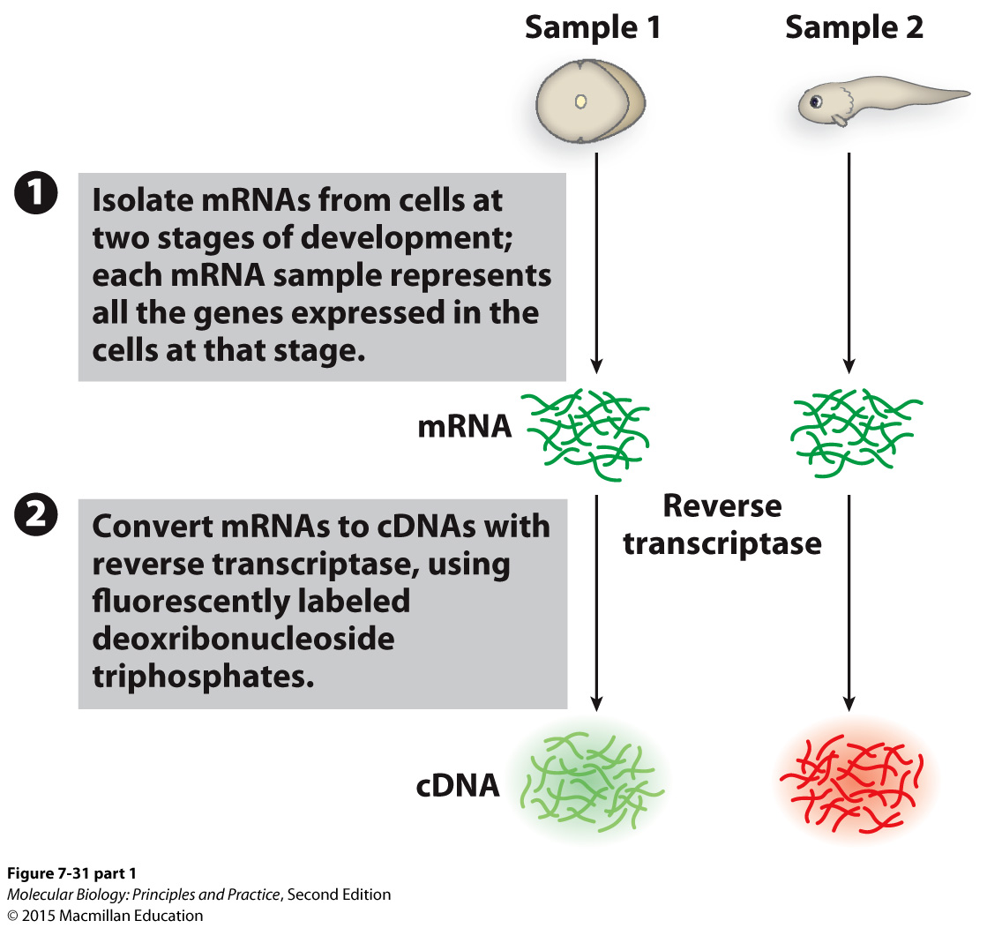
Microarrays

Slide 15
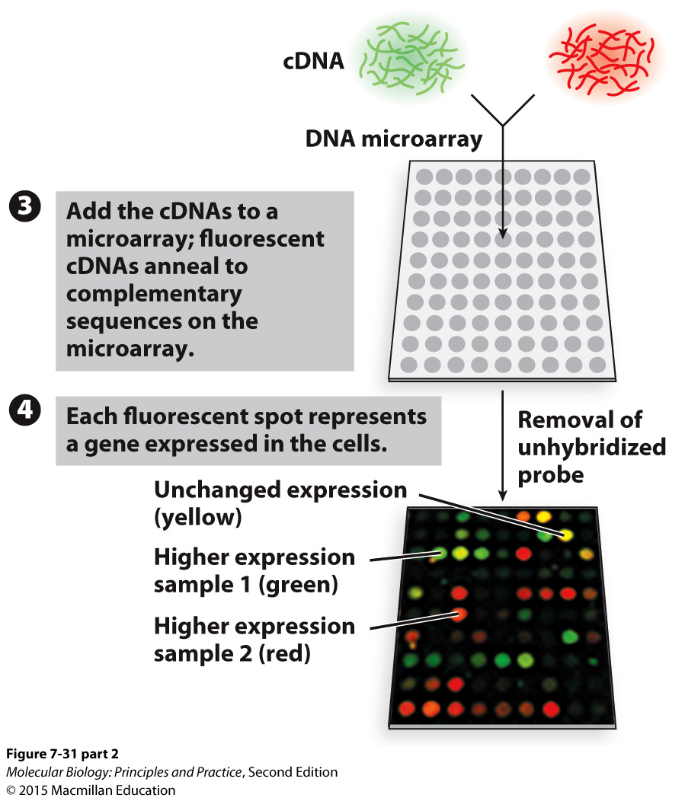
Microarrays

Slide 16
Microarrays advantages and disadvantages
Advantages:
Look at thousands of genes simultaneously
Commercially available for many organisms
No amplification
Disadvantages:
Expensive
Requires a substantial amount of sample
Limited dynamic range
You can only detect genes for which you have probes (you need to know what you are looking for)

Slide 17
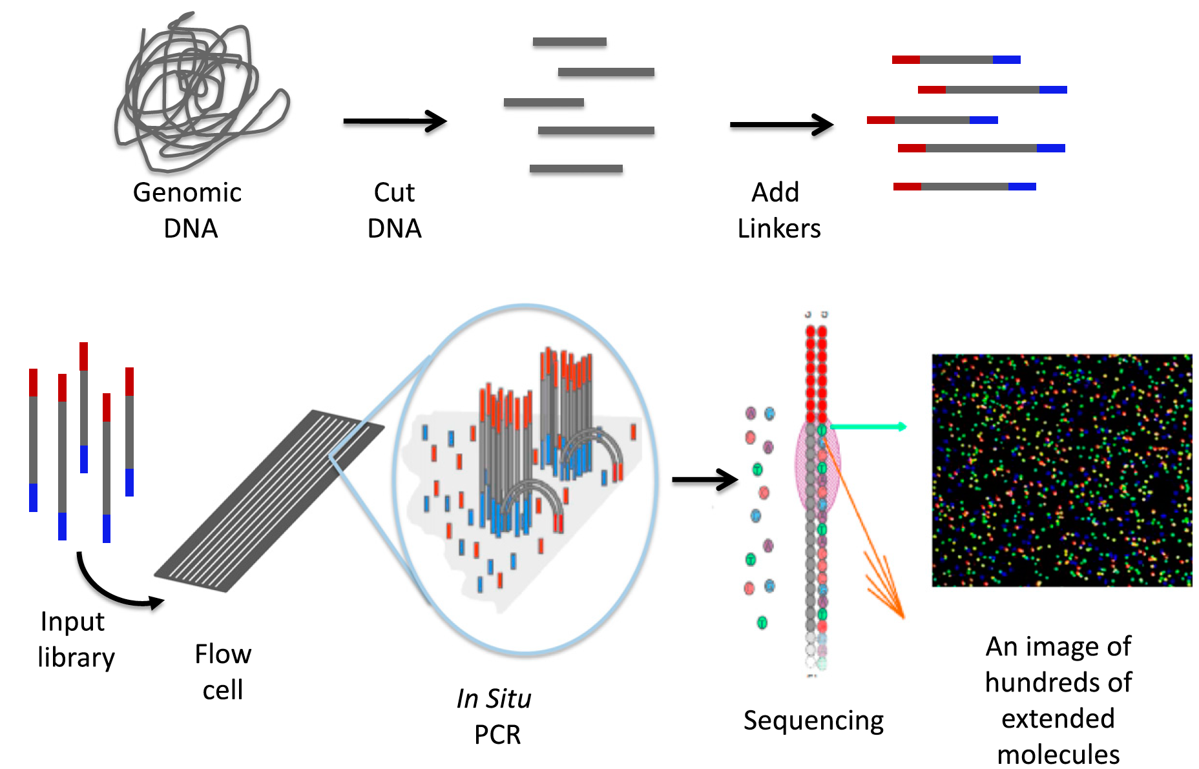
Measuring gene expression by RNAseq
Shear and reverse transcribe
RNA
cDNA
Library
Johnsen J M et al. Blood 2013;122:3268-3275
©2013 by American Society of Hematology
Notes:
Schematic of 1 form of NGS. The process starts by randomly cutting genomic DNA (or cDNA) into short fragments (a few hundred base pairs in length). Oligonucleotide linkers are added to the fragments to generate a library in vitro. Libraries are introduced into a microscope slide with flow channels containing complementary oligonucleotides on the surfaces of the channel to ones on the libraries, thus allowing hybridization to attach millions of individual molecules to discrete locations on the slide. In situ PCR is performed to copy the individual fragments of the library to enhance sequencing detection. Single-base extension by a DNA polymerase with all 4 dye terminators extends the sequence 1 base. The image of the base extension is captured. This cycle and is repeated a 100 times from 1 end of the molecule and 100 times from the other.

Slide 18
Visualizing Illumina data in a genome browser
Genomic DNA sequencing:
RNAseq:

Slide 19
Comparing two strains by RNAseq
Number of reads at each position

Slide 20
Comparing two strains by RNAseq
Number of reads at each position
Quantification: count and compare reads aligning to each gene

Slide 21
Next-gen DNA sequencing and RNAseq collect the same type of data, but it is analyzed differently
Genomic DNA sequencing:
RNAseq:

Slide 22
RNAseq advantages and disadvantages
Advantages:
Look at thousands of genes simultaneously
Large dynamic range
Small amount of starting material is okay
No prior knowledge of expressed regions is needed
Can sometimes get additional information besides expression levels (transcription start sites, splice variants)
Disadvantages:
Expensive
Involves PCR which can lead to bias

Slide 23
Gene expression can be measured at the level of protein too
Western blotting
Mass spectrometry
Reporters
Reporter example: use a promoter from a gene of interest to drive expression of GFP (green fluorescent protein). GFP levels “report” how much expression occurrred.

Slide 24
Quiz 3 distribution of grades
Mean: 85.22
Median: 92

